Slide 1
Enterprise Applications and Business Processes

Slide 2
Outline
Objectives
On completing this module, you will be able to:
Appreciate the existence of different enterprise applications that are used in an enterprise
Understand the role of an enterprise application in the context of a business process
Understand the need for data exchange between different enterprise applications
Understand the differences among the three categories of enterprise applications
Topics
Enterprise Applications
Uses of Enterprise Applications in Business Process
Enterprise Solution
Notes:
Business Process definition: cf. IS210 Business Process Analysis and Solutioning

Slide 3
Activity
http://www.amazon.com
Identify some applications that may be involved in the business process(es) for buying a book from amazon.com
Example – Product Management System (PMS)
Describe how the application(s) may be used in the business process(es) and what information may be involved in the application(s) and the process(es)
Example - PMS
Manage product details-Product description, quantity, price, etc.
Provide data to the web UI for users to browse the products
Send alerts to a supplier system when inventory is low
Notes:
We treat IT systems (and simply, systems) as a synonym of enterprise applications.

Slide 4
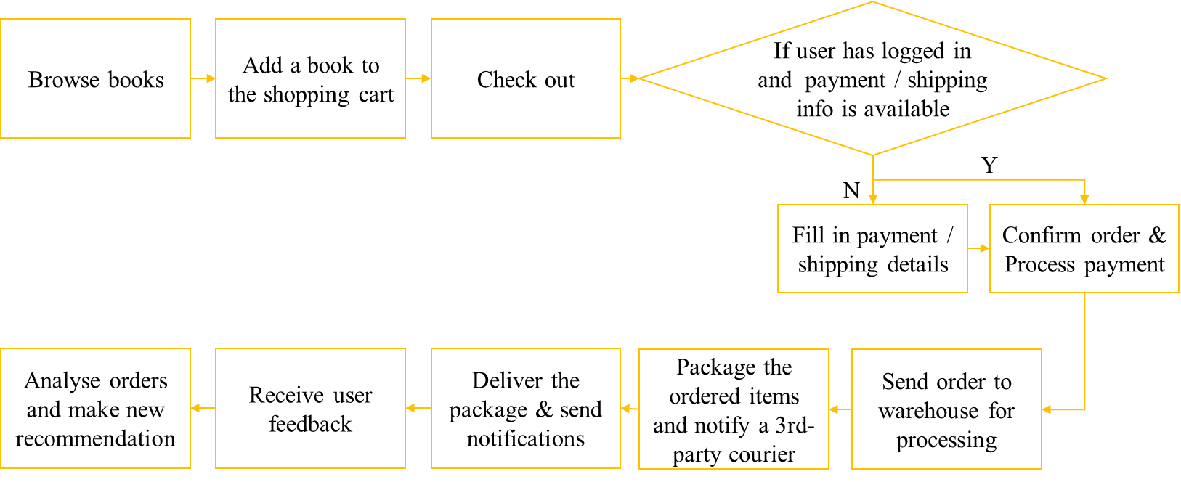
Activity - Sample Business Process
Consider the sample process for placing a book order and processing the order for shipping
Alternatively, think of your own processes
List a few possible major steps (with your own intuitions);
No need to match the real one or be comprehensive;
May add in some error handling steps, or data analytics steps.
user
amazon

Slide 5
Sample Solution: Enterprise Applications in Amazon
Product Management System
Manage product details-Product description, quantity, price, etc.
Send alerts to supplier system when inventory is low
Customer Relationship Management (CRM) System
Manage customer details- Name, address, membership status level, credit card details, etc.
Manage sales opportunity- learn about the customers’ needs and buying behavior and combine this information with market information to enhance the quality of the company’s marketing plans and sales forecasts
Accounting System
Calculate the total price for the products ordered
Generate the billing order/invoice/receipt that is sent to the customer along with the product
Create financial statements
Delivery System
Generate the shipping order that is sent to the warehouse for dispatch
Send the delivery notice to the courier company system

Slide 6
Enterprise
As defined by Cambridge Dictionary, an enterprise is: an organization, a company, or a business:
a manufacturing/catering/farming enterprise
a large/small/medium-sized enterprise/start-up
a state/state-owned/multinational enterprise/government agency
a domestic/local/foreign enterprise
Can include for-profit and not-for-profit
Will include people, business processes and products/services
Notes:
The "service" here means a general kind of service, not just the software service that we will talk about later in this course.

Slide 7
A Typical Enterprise Ecosystem
Process
People
Process
People
Products/Services
Products/
Services
Enterprise A
Enterprise B
(e.g. Amazon)
(e.g. DHL)
(e.g. Coca Cola)
(e.g. NTUC Fairprice)
(e.g. HPB)
(e.g. NTUC Fairprice)
Notes:
HPB: Health Promotion Board. It issues health award points for buying healthy food from NTUC

Slide 8
Applications in an Enterprise
Within each function/department/business unit, people play different roles and produce/process different kinds of data.
Examples: in the Finance & Accounting Unit- CFO, Accounts Payable Manager, Accounts Receivable Manager, etc.
Each role may be involved in various business processes and perform various activities.
Examples: a CFO role may be in various finance-related processes, e.g., budgeting, or auditing
An activity in a business process often relies on enterprise applications.
Examples: An Excel file with some formulas and Macro for accountants to track cash flows; a customized web-based dashboard for CFO to prepare and view financial statements.
Notes:
Enterprise applications may be referred to as IT Systems, IT applications, software systems, software programs, etc.
We don't talk about hardware in this course, although hardware can be part of enterprise ecosystems.

Slide 9
Sample Function/Business Units in an Enterprise
Purchasing
Manufacturing
Warehouse
Marketing & Sales
Research & Development
Finance & Accounting
Human Resources
IT Support

Slide 10
Interactions among Enterprise Applications
An activity performed by a person in an enterprise can affect other parts of the enterprise or other enterprises according to the business processes
Examples: CFO views the financial statement that aggregates data from Account Payable Manager, Account Receivable Manager; delivery notices may trigger reactions from the courier's systems; etc.
Enterprise applications supporting the activities need to interact and collaborate.
The same application can be (re)used to support different activities in different business processes
Example: the Excel file for tracking cash flow can be used for financial statement generation too.

Slide 11
Role of Enterprise Applications in Business Process
An activity (can be interactive or automated) in a business process often needs supports from enterprise applications
An enterprise application is to support various activities in various business processes
In the context of a business process, an enterprise application can
Provide interface for a user to perform a business activity
Apply pre-defined business rules (logic) to process input data
Analyze data
Produce new data
Store data
Retrieve data
Send data to another application
…
Enterprise Application
Input data
Output data

Slide 12
Need for Enterprise Applications to Exchange Data
An enterprise is bound to have many applications that support different business activities and handle different data relevant to different parts of the enterprise
Some business processes require applications from two or more enterprises to collaborate
Not all activities or data can be supported or handled in one application
Automating the exchange of data among applications helps to automate business processes and improve productivity

Slide 13
Enterprise Solution
Typically, an enterprise solution refers to one or more enterprise applications that produce, process and exchange data in order to fulfil business requirements
E.g., automate the book order handling & shipping process in a bookstore; aggregate all relevant information on a single interactive dashboard

Slide 14
Some characteristics of Enterprise Applications & Solutions
Support business activities & processes
Store a lot of persistent data
In files, relational databases, NoSQL databases, etc.
Data is often accessed and processed concurrently
Potentially for many internal and external users
Provide a lot of user interface screens
The same data can be processed or viewed in different ways in different processes by different people.
Not all processing happens real-time online; some offline (batch) processing is used.
Example: generating monthly financial statements
Source: Adapted from martinfowler.com
Notes:
Real-time online processing happens immediately e.g. payment
Offline processing is performed in batches e.g. delivery

Slide 15
Some characteristics of Enterprise Applications & Solutions
Can be large or small, simple or complex
Examples: large complex CRM; small simple calendar app;
Process data according to business logics/requirements
Can be in the form of executable rules. E.g., For every $10 purchased, give the customer 1 loyalty point
It is a challenge to make applications easily adaptable to changing requirements
A large enterprise often has applications that were built over many years using different technologies
Often need to exchange data among applications
It is a challenge to enable data exchange among various kinds of applications
Source: Adapted from martinfowler.com
Notes:
The two challenges will be addressed as part of the course learning outcomes by following a methodical approach to develop a service-oriented architecture for building enterprise solutions
.

Slide 16
Activity
Read the Mini Case: Categories of enterprise applications and answer the following question
Examine the characteristics/attributes of the different applications and group them into the following three different categories
Commercial-Off-The-Shelf
Custom
Legacy
Identify the key characteristics/attributes that differentiate the three different categories
Discuss possible pros and cons of using applications of different categories in supporting business processes.

Slide 17
Three categories of Enterprise Applications
Category | Application Names
COTS
Custom
Legacy
Category | Characteristics/Attributes
COTS
Custom
Legacy

Slide 18
Potential Pros and Cons of the Three Application Categories
Category | Potential Pros and Cons if used for a business process
COTS
Custom
Legacy
Notes:
Among various factors, may consider the two challenges mentioned earlier for pros/cons:
Is it easy to be adaptable to changing requirements?
Is it easy to enable data exchange among various kinds of applications?

Slide 19
Sample Solution: Three categories of Enterprise Applications
Category | Application Names
COTS | Zoko Supplier Management System (ZSMS), Zoko Customer Relationship Management System (ZCRMS), Zoko Sales Transaction System (ZSTS)
Custom | Zoko Sales Analytics System (ZSAS), Zoko HR System (ZHRS), Zoko Online Sales System (ZOSS)
Legacy | Zoko Sales Transaction System (ZSTS), Zoko Online Sales System (ZOSS)
Category | Characteristics/Attributes
COTS | Buy from an external vendor. The software package is pre-built with "best practices". Not adapted to specific requirements of a customer.
Custom | Built from scratch either using in-house or external developers according to specific requirements of a customer. Require in-house expertise or external partners.
Legacy | Old systems that have been built many years before using old technologies that may not be widely used now

Slide 20
Sample Solution: Potential Pros and Cons of the Three Application Categories
Category | Potential Pros and Cons if used for a business process
COTS | Provide the required functionality out of the box; may be more reliable with tech supports; If using standardized technologies or providing documented APIs, easier to exchange data with other applications; If using proprietary technologies without APIs or customizability, may be more difficult to be used for a process; may be expensive to buy;
Custom | May be costly and unreliable in building the functionality; may be expensive to build from scratch; Internally built may make it easier to use it for the processes within the same enterprise and exchange data with other applications, but may be harder to work with applications from other enterprises;
Legacy | Provide required functionality; may be more stable; but interface, data format, etc. may be old and incompatible with new technologies, making it harder to exchange data with newer applications; may be expensive to maintain for a long term;

Slide 21
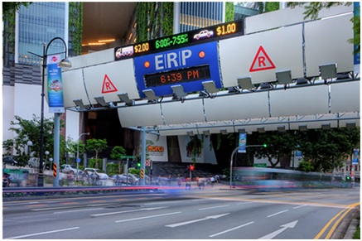
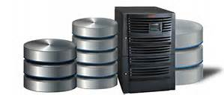
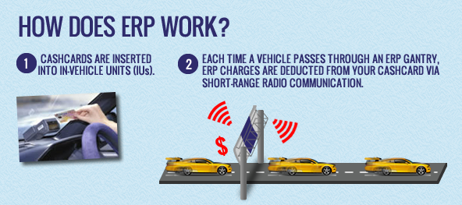
Sample Enterprise Solution
In-Vehicle Unit
Cash Card
ERP Gantry with sensors
Camera System for taking photos and recognizing licenses
LTA DB containing drivers’ and vehicles’ information
Billing System for payment processing
Traffic Analysis System for better optimization
Image courtesy: http://www.lta.gov.sg/
Notes:
From Wikipedia: In some cases, the implementation of an ERP gantry along a road may move the traffic to smaller roads. One instance of this is that the ERP gantry along the Central Expressway (CTE) has been said to have caused traffic to increase substantially in north-south trunk roads, such as along the Thomson Road and Serangoon Road corridors. The rising traffic prompted the LTA to add a gantry along Thomson Road, while Upper Serangoon Road's capacity was increased somewhat with the building of a new viaduct. Similarly, the ERP gantry on the East Coast Parkway's west-bound carriageway was said to have led to increased traffic on Geylang Road and Nicoll Highway, where ERP gantries were also placed subsequently.
ERP 2.0 with satellites and on-street equipment may enable distance-based fee charging. From November 2023, LTA is progressively installing new On-Board Units (OBUs) in vehicles: https://onemotoring.lta.gov.sg/content/onemotoring/home/driving/ERP/erp-2-0.html

